Slide 1
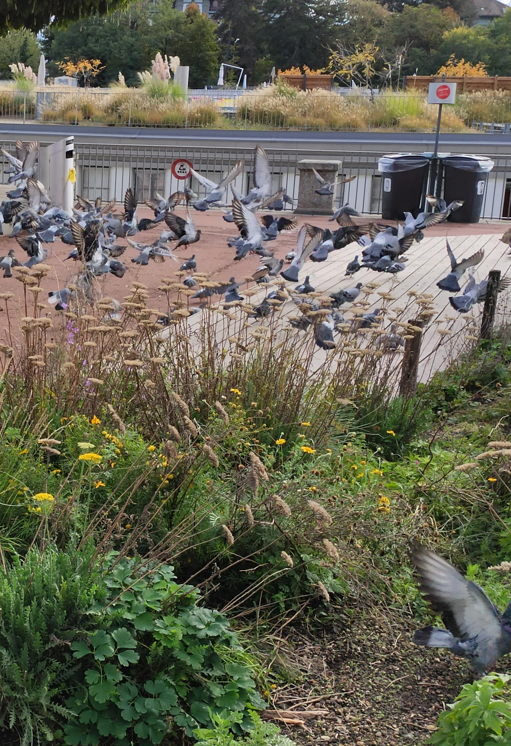
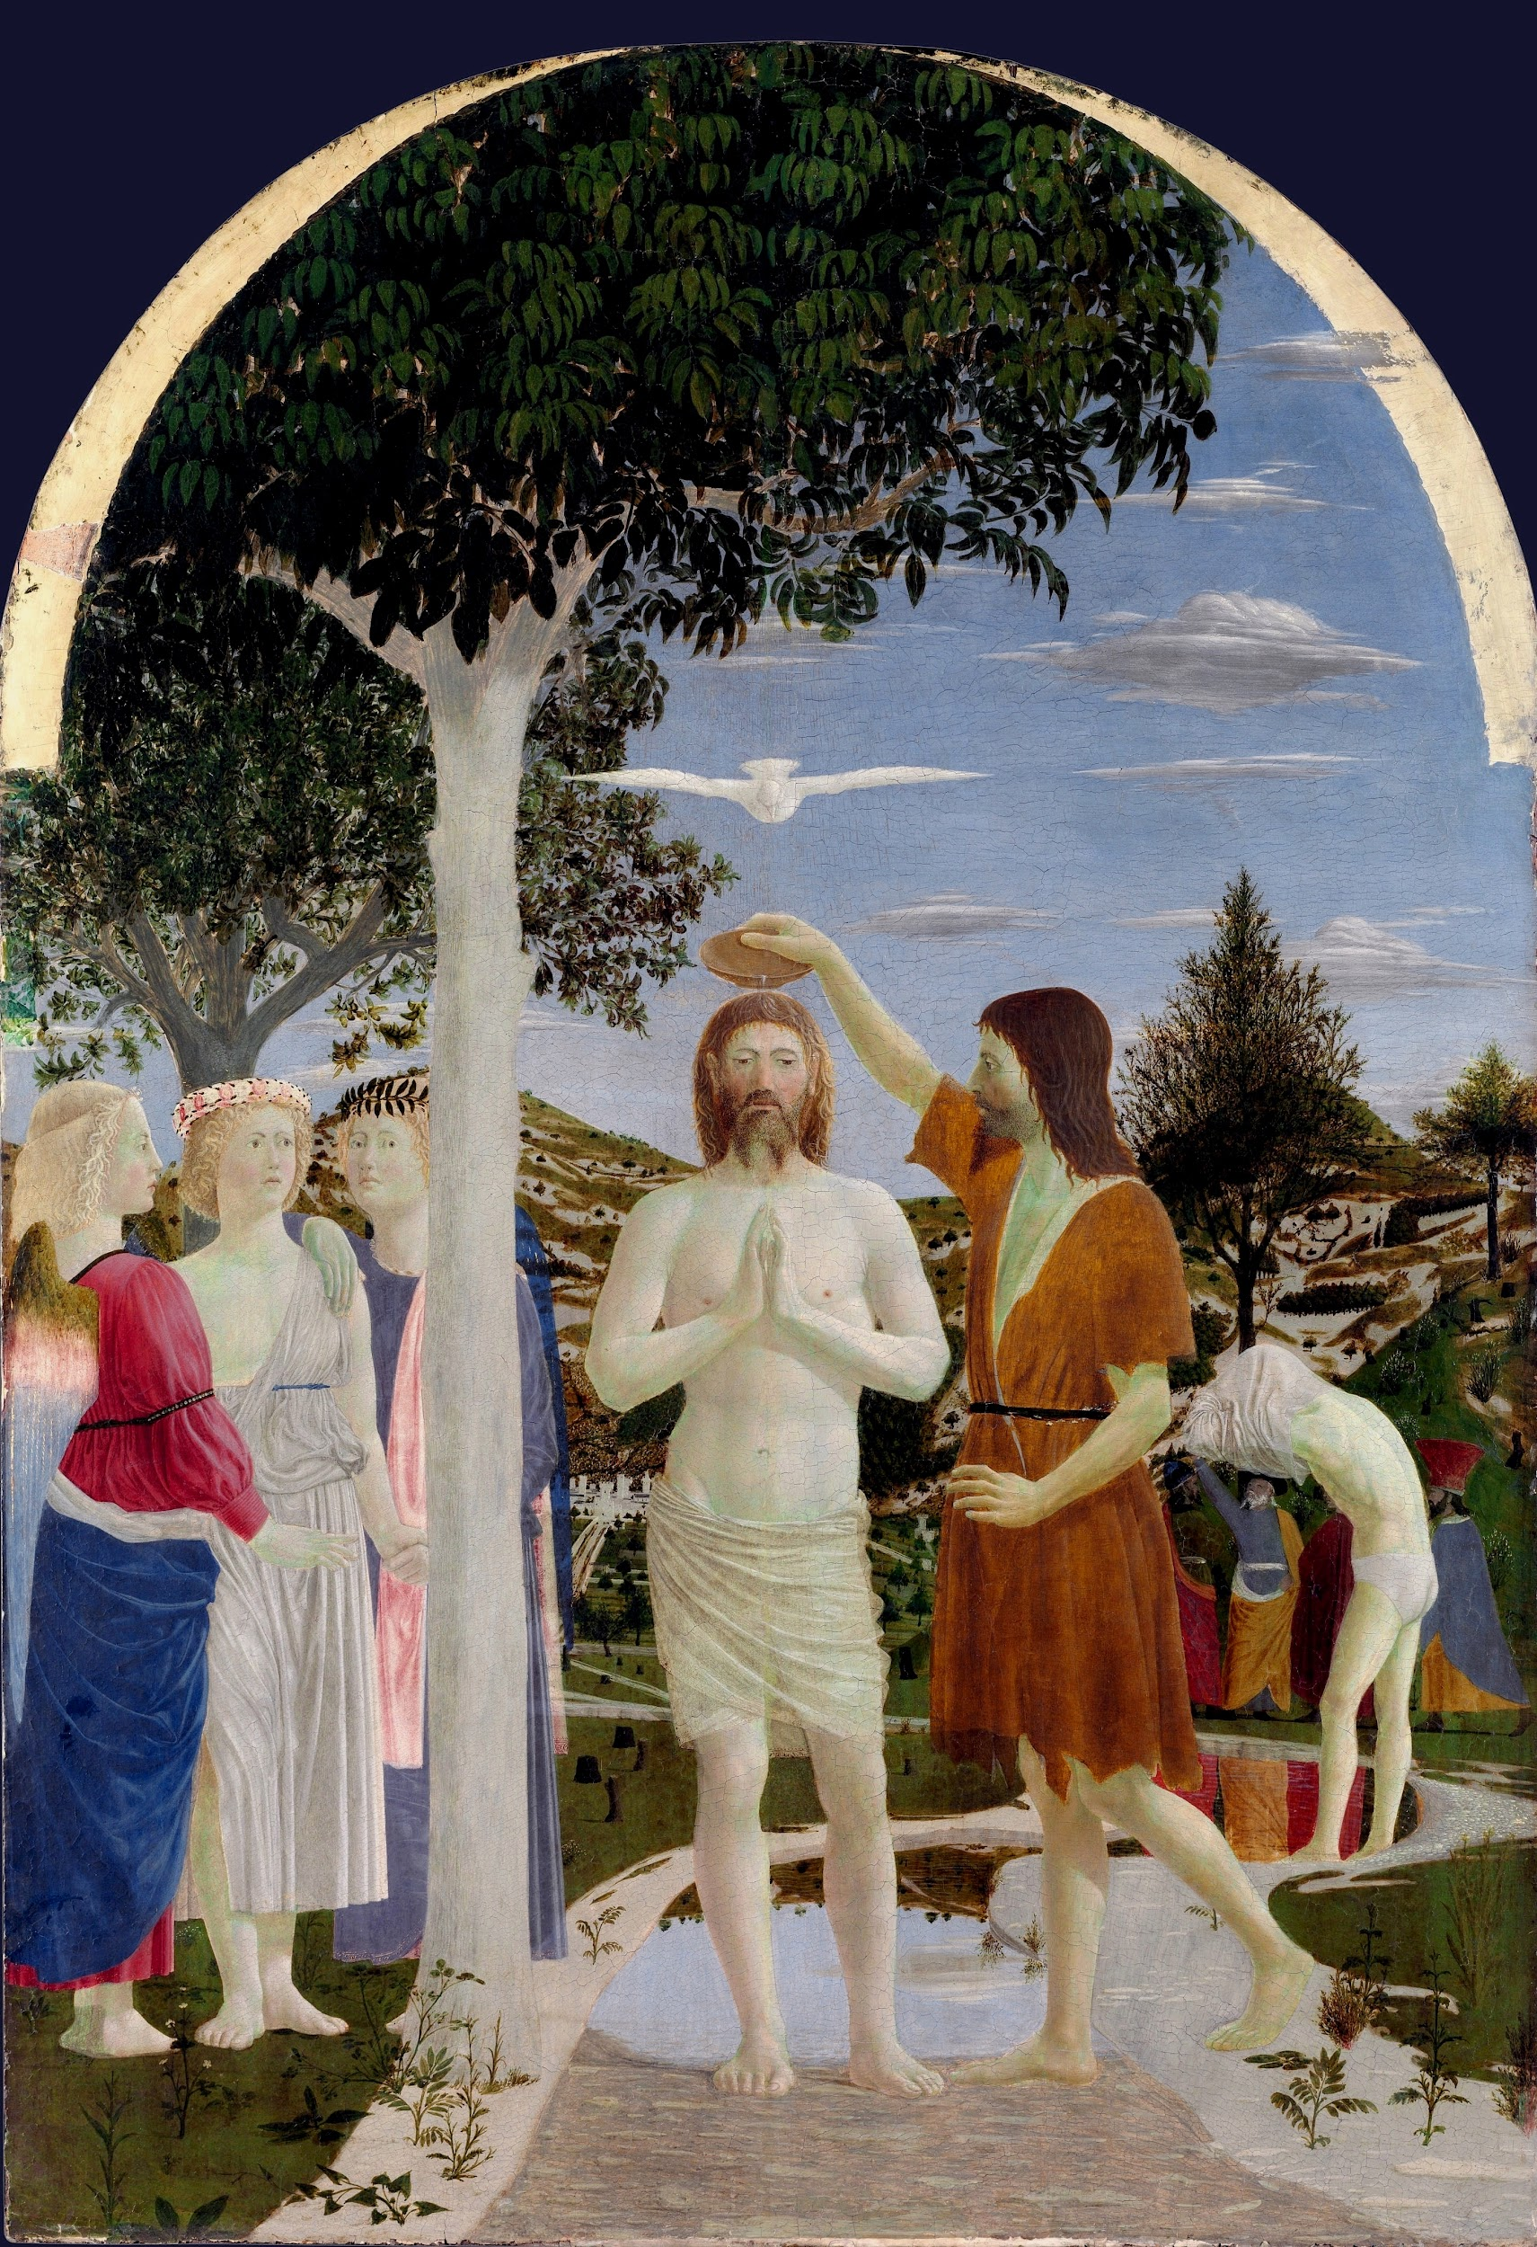
Idea
Notes:
Integrating insights about social and technological change in artefacts
Exploring and criticizing possible futures by creating fictional, and often provocative, scenarios presented through tangible artefacts.
spark conversations about the near future, check the sanity of their visions and uncover hidden perspectives.
What could be the new relationships we could build with animals in urban contexts of the near future?
"faint signals”: ingredients and stimuli for building design fiction: the signals of change from which you extrapolate, something curious you observe from time to time that may become a norm in the future
The idea is grounded in the social, it is a psychological reaction to the ever growing presence of pigeon in the urban environment. This might create certain a fascination and unsettlement in humans, that try to explain their emotion by means of a religion. Some ‘faint signals’ of this change can be seen in the figure of the old man feeding pigeons. This figure is affine to those of frugal and mysterious monks. This religion constitutes the discovery of a new relationship between men and urban animals, that shifts from carelessness to veneration.
The idea is also culturally grounded on the idea of birds are divinatory animals.

Slide 2
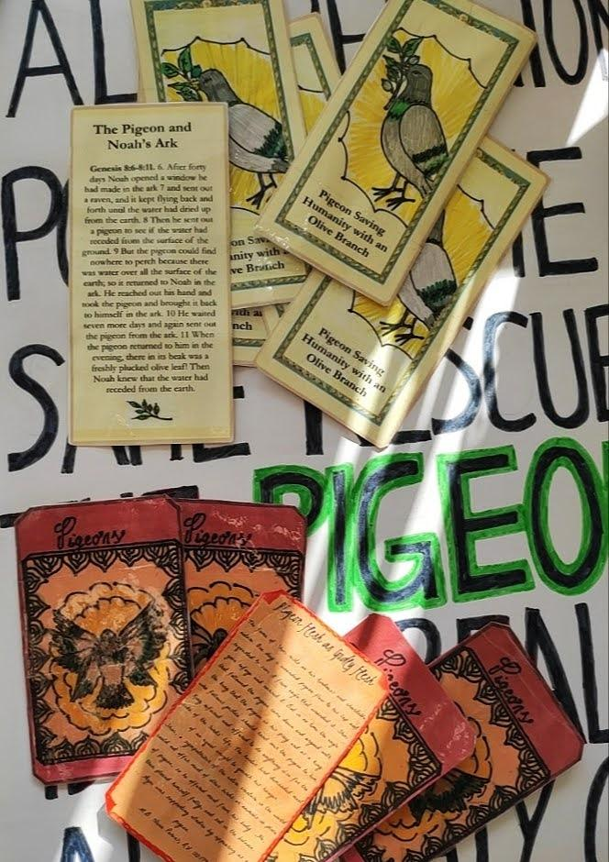
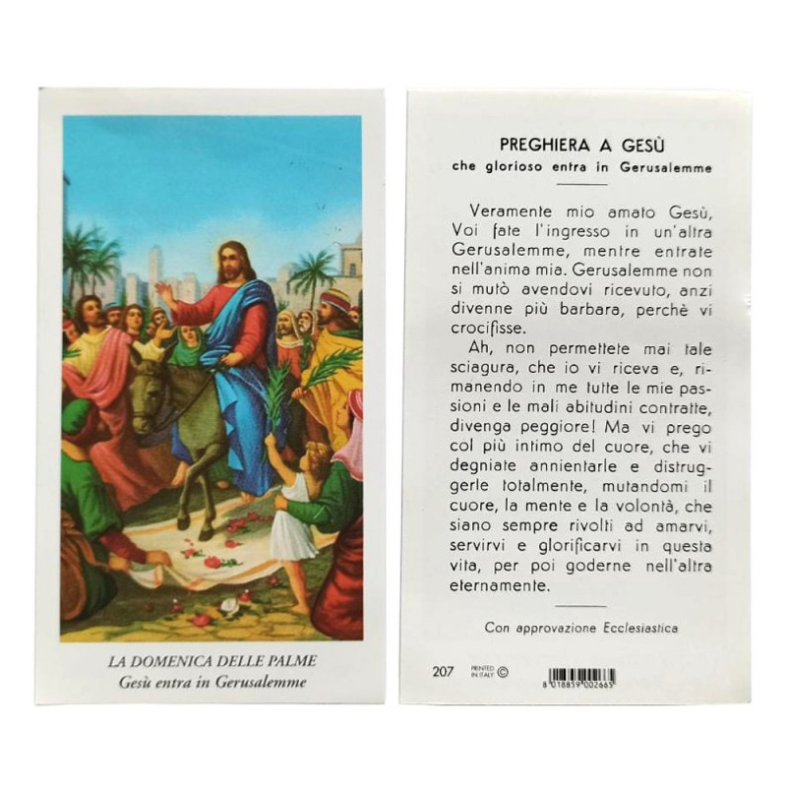
Format
Notes:
The formats you chose should preferably be rich enough to demonstrate your idea AND highlight potential opportunities, problems or controversies raised by it.
Picture of the two santini and of the cartellone
Format is typical of religions. The design is used to convey the worship basis of this religion: it is a transcendental religion that spans over all well grounded religions. Pigeons appear in all religions as saviours, we can take the example of christianity that sees the dove as the holy spirit. For all this time we have not realized that all these religions were correct, but their focus was off. The real god they were depicting as the Pigeon. He is the only animal that inhabits cities as well as countrysides, this is because it is close to all living forms and it guides them through life.
Experimented with different styles, eventually decided to adopt the styles of the religions that this creed is based on, this time shifting the attention to the role of the pigeon. Even in the drawings and the scripture, these were roughly copied from the religions and adjusted to place the pigeon at the centre. This was also justified by the fact that this religion was not rationally originated, while it was the result of a human pulsion, the style is not coherent (take for instance pastafarians) and it is not uniform.

Slide 3
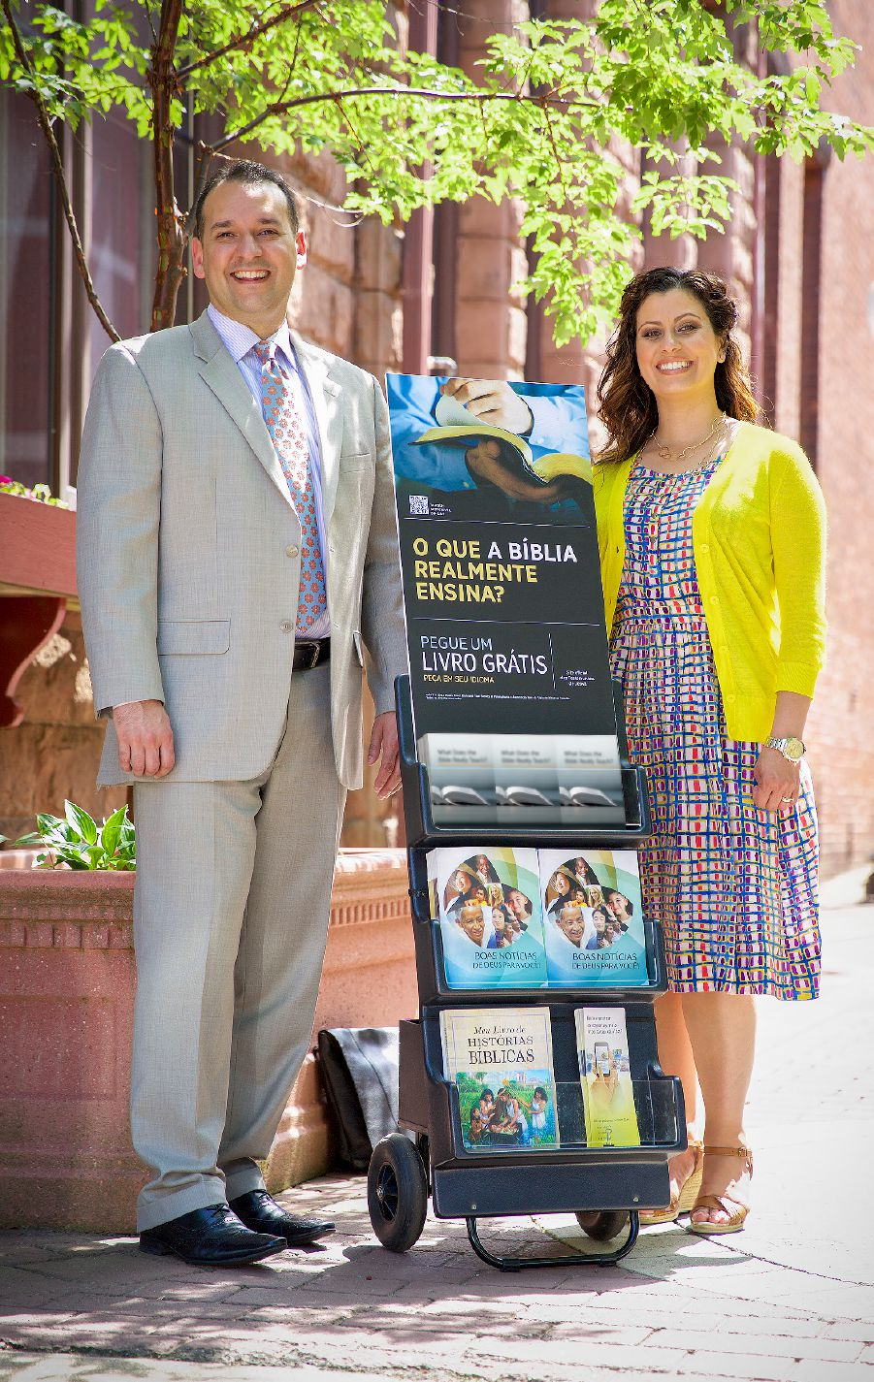
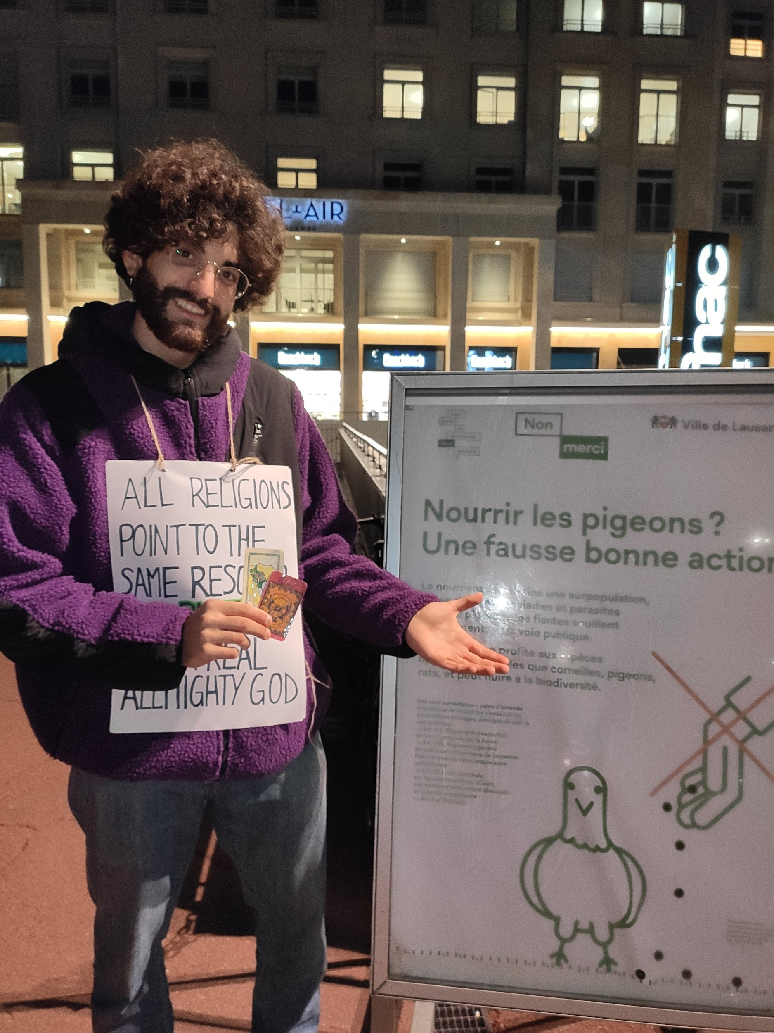
Context
Notes:
please take a photo (or a short video) of the design fiction you created IN CONTEXT
put picture of Davide approaching someone with pigeons in the back.
The context was chosen to mimic the activity of many of these newborn religions that do proselytism in the streets. This format is easy to relate to and it should immediately link this religion to those the design fiction aims at criticizing

Slide 4

Pigeon Religion
Ludovica Schaerf

Slide 5
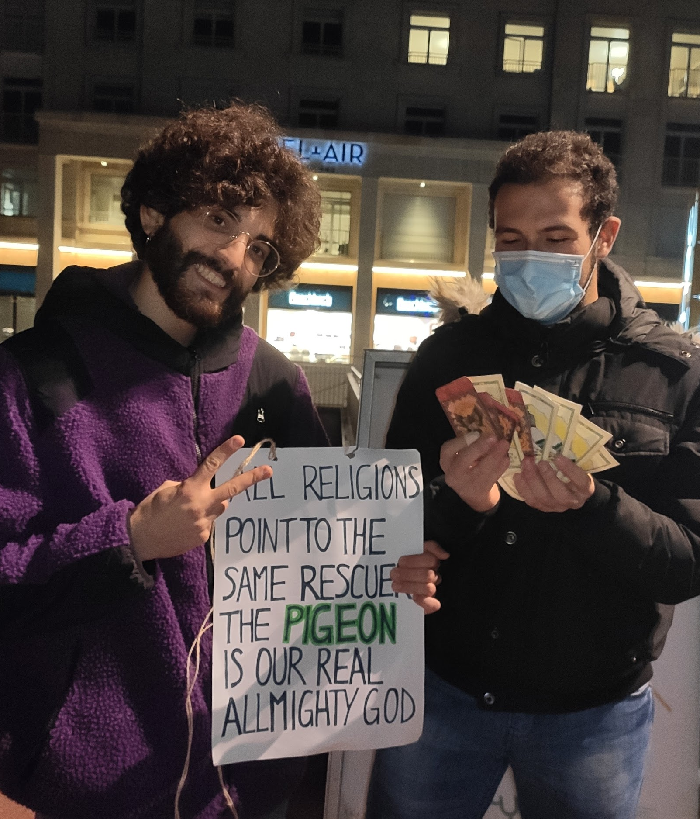
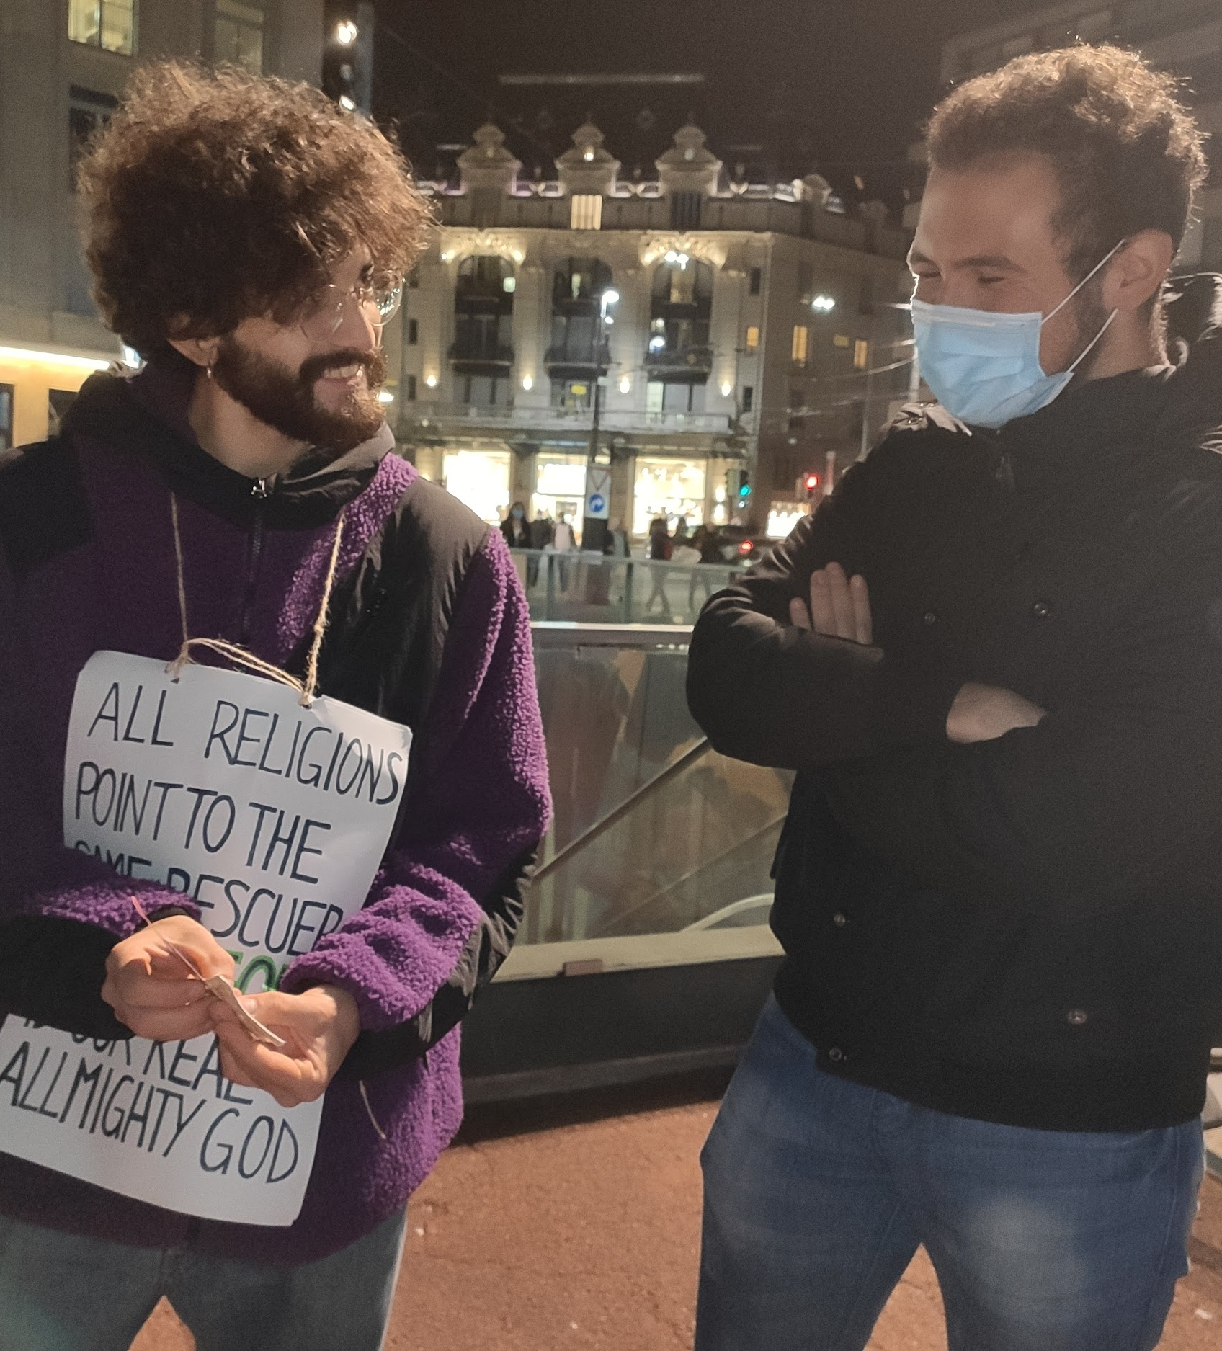
To convert to the pigeon religion and achieve salvation please contact: ludovica.schaerf@pigeonreligion.ch

